Slide 1
Part B: Software testing
Software testing - strategies (9/DG)
Software testing - Implementation (10/DG)

Slide 3
Software testing - strategies
Presentation 9
1. Definitions and objectives
2. Software testing strategies
3. Software test classifications
4. White box testing
5. Black box testing

Slide 4
1. Definitions and objectives
Intro:
Software testing (or “testing”) was the first software quality assurance tool applied to control the software product’s quality.
At first, testing was confined to the final stage of development, after the entire package had been completed.
Later, SQA professionals were encouraged to extend testing to the partial in-process products of coding, which led to software module (unit) testing and integration testing.

Slide 5
1. Definitions and objectives
Intro:
In a survey performed in November 1994, Perry (1995) found that on average, 24% of the project development budget was allocated
to testing.
In addition, 32% of the project management budget was slated
for testing activities.

Slide 6
1. Definitions and objectives
Def:
Classic definition (Myers, 1979): “Testing is the process of executing a program with intention of finding errors.”
Software testing is a formal process carried out by a specialized testing team in which a software unit, several integrated software units or an entire software package are examined by running the programs on a computer.
All the associated tests are performed according to approved test procedures on approved test cases.

Slide 7
1. Definitions and objectives
Direct objectives
To identify and reveal as many errors as possible in the tested software
To bring the tested software, after correction of the identified errors and retesting, to an acceptable level of quality.
To perform the required tests efficiently and effectively, within the limits budgetary and scheduling limitation.
Indirect objective: To compile a record of software errors for use in error prevention (by corrective and preventive actions)

Slide 8
2. Software testing strategies
Incremental testing strategies:
Bottom-up testing
Top-down testing
Big bang testing
To test the software in its entirety, once the completed package is available; otherwise known as “big bang testing”

Slide 9
Bottom-up testing
Stage 1: Unit tests of modules 1 to 7.
Stage 2: Integration test A of modules 1 and 2, developed and tested in stage 1, and integrated with module 8, developed in the current stage.
Stage 4
M11
Integration B
Integration c
Stage 3
M9
M10
Stage 3: Two separate integration
tests, B, on modules 3, 4, 5 and 8,
integrated with module 9, and C,
for modules 6 and 7, integrated with module 10.
Integration A
Stage 2
M8
Stage 4: System test is perfor-med after B and C have been integrated with module 11, developed in the current stage.
Stage 1
M1
M2
M3
M4
M5
M6
M7

Slide 10
Stage 1: Unit tests of module 11
Top-down testing
Stage 2: Integration test A of module 11 integrated with modules 9 and 10, developed in the current stage.
Integration D
Integration C
Integration B
Stage 3: Integration test B of A integrated with module 8, developed in the current stage.
Integration A
Stage 1
M11
M9
M10
Stage 4: Integration test C of B integrated with modules 6 and 7, developed in the current stage.
Stage 2
Stage 3
M8
Stage 5: Integration test D of C integrated with modules 1 and 2, developed in the current stage.
Stage 4
M6
M7
Stage 6: System test of D inte-grated with modules 3, 4 and 5, developed in the current stage.
Stage 5
M1
M2
Stage 6
M3
M4
M5

Slide 11
Use of stubs and drivers
for incremental testing
Top-down testing of module M8
Bottom-up testing of module M8
M9
Module tested in an earlier stage
Drive
of M9
M8
M8
Module on test
Module on test
Modules tested in an earlier stage
Stub
of M1
Stub
of M2
M1
M2

Slide 12
3. Software test classifications
There is an ongoing debate over whether testing the functionality of software solely according to its outputs is sufficient to achieve an acceptable level of quality.
Some claim that the internal structure of the software and the calculations (i.e., the underlying mathematical structure, also known as the software “mechanism”) should be included for satisfactory testing.

Slide 13
3. Software test classifications
Based on these two opposing concepts or approaches to software quality, two testing classes have been developed:
■ Black box (functionality) testing. Identifies bugs only according to software malfunctioning as they are revealed in its erroneous outputs. In cases that the outputs are found to be correct, black box testing disregards the internal path of calculations and processing performed.
■ White box (structural) testing. Examines internal calculation paths in order to identify bugs

Slide 14
3. Software test classifications
Black box and white box testing – IEEE definitions
Black box testing:
(1) Testing that ignores the internal mechanism of a system or component and focuses solely on the outputs generated in response to selected inputs and execution conditions.
(2) Testing conducted to evaluate the compliance of a system or component with specified functional requirements.
White box testing:
Testing that takes into account the internal mechanism of a system or component.

Slide 15
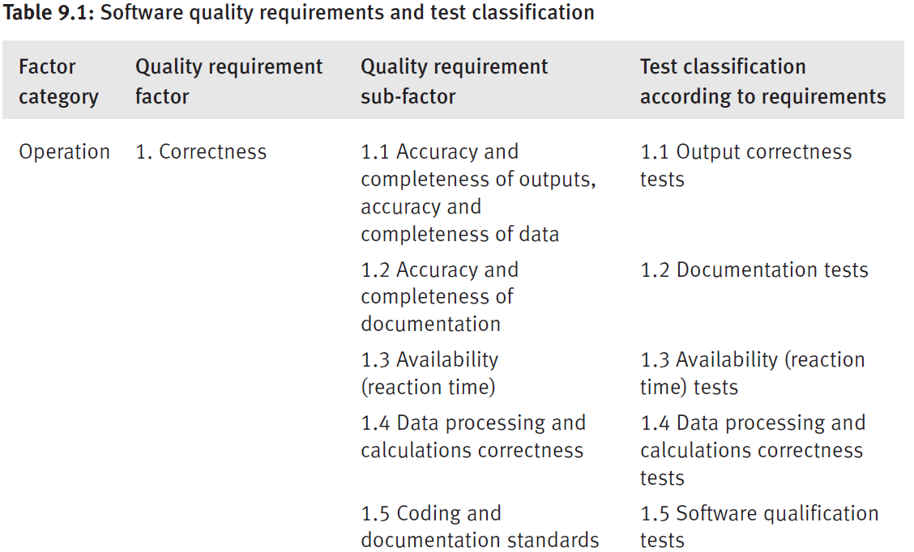
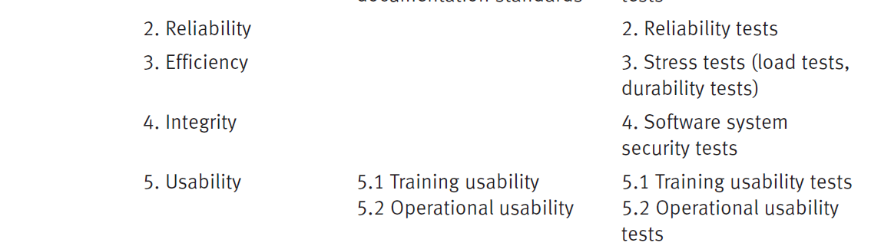
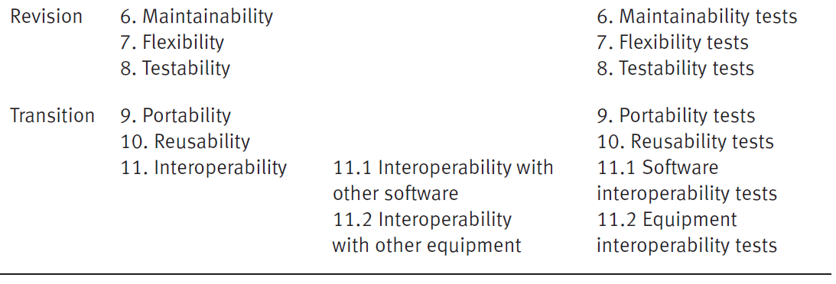

3. Software test classifications
Classification according requirements

Slide 16
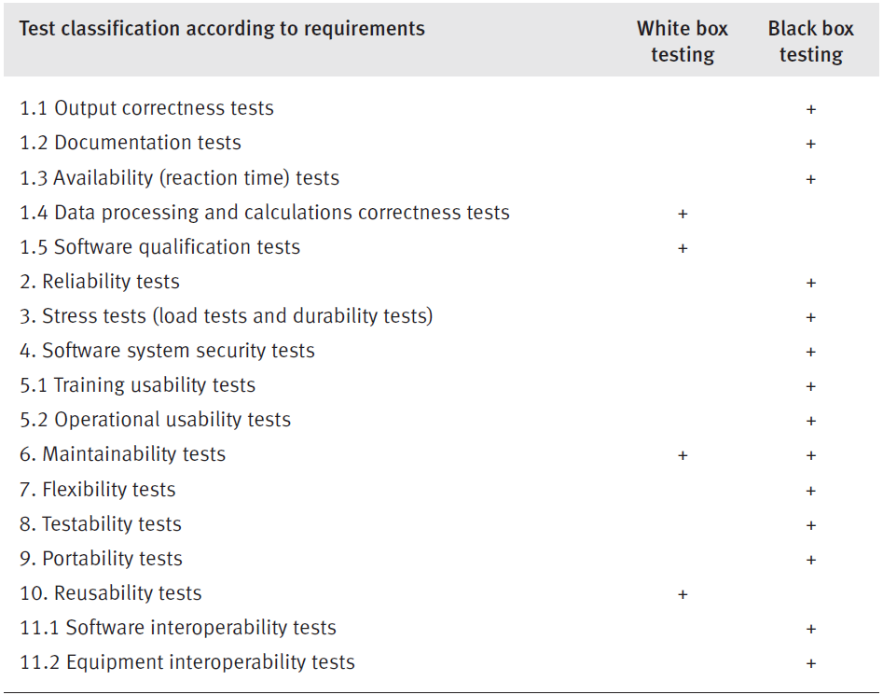
3. Software test classifications
White box and black box testing for the various classes of tests

Slide 17
4. White box testing
Realization of the white box testing concept requires verification of every program statement and comment.
As shown in preview Table, white box testing enables:
performance of data processing and calculations correctness tests,
software qualification tests,
maintainability tests
reusability tests.

Slide 18
3. Software test classifications
White box and black box testing for the various classes of tests

Slide 19
4. White box testing
Performance of data processing and calculations correctness tests
In order to perform data processing and calculation correctness tests
(“white box correctness test”), every computational operation in the
sequence of operations created by each test case (“path”) must be examined.

Slide 20
3. Software test classifications
White box and black box testing for the various classes of tests

Slide 21
4. White box testing
Software qualification tests
The focus here shifts to the examination of software code (including comments) compliance with coding standards and work instructions.
Software qualification testing establish whether software development responded positively to questions reflecting a specific set of criteria:
■ Does the code fulfill the code structure instructions and procedures, such as module size, application of reused code, etc.?
■ Does the coding style fulfill coding style procedures?
■ Do the internal program documentation and “help” sections fulfill coding style procedures?

Slide 22
4. White box testing
Maintainability tests
Maintainability tests refer to special features, such as those installed for detection of causes of failure, module structures that support software adaptations and software improvements, etc.
Reusability tests
Reusability tests examine the extent that reused software
is incorporated in the package and the adaptations performed in order to make parts of the current software reusable for future software packages.
Reusability testing supports these functions by determining whether the packaging and documentation of the programs and modules listed for reuse conform to the standards and procedures demanded for inclusion in the reusable software library.

Slide 23
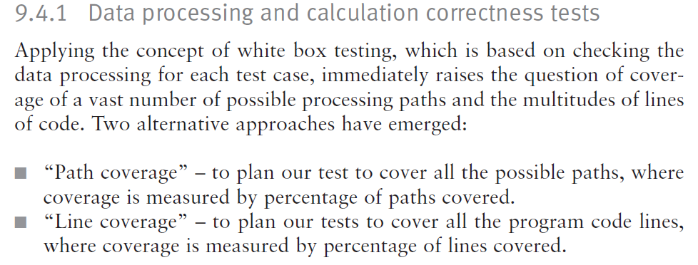
4. White box testing
Maintainability tests
.

Slide 24
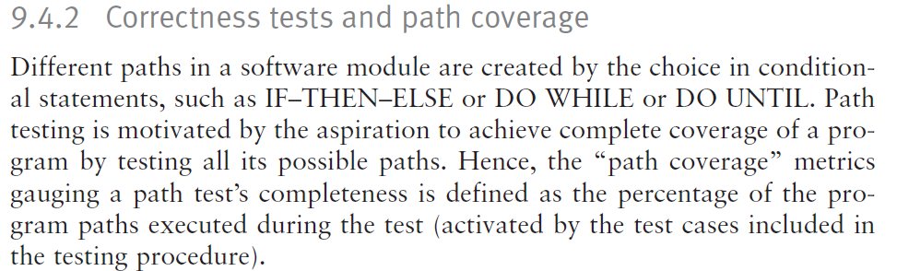
4. White box testing
Maintainability tests
.

Slide 25
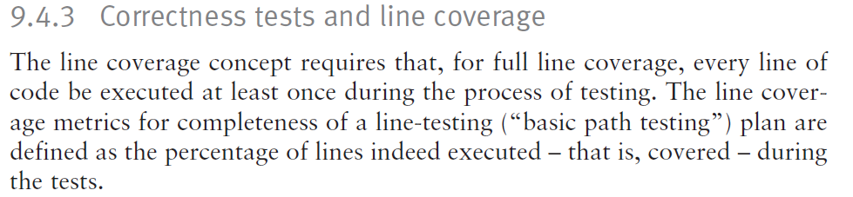
4. White box testing
Maintainability tests
.

Slide 26
4. White box testing
The main disadvantages of white box testing are:
■ The vast resources utilized, much above those required for black box testing of the same software package.
■ The inability to test software performance in terms of availability
(response time), reliability, load durability, and other testing classes related to operation, revision and transition factors.

Slide 27
Example: – The Imperial Taxi Services (ITS) taximeter
Imperial Taxi Services (ITS) serves one-time passengers and regular clients (identified by a taxi card).
The ITS taxi fares for one-time passengers are calculated as follows:
(1) Minimal fare: $2. This fare covers the distance traveled up to 1000 yards and waiting time (stopping for traffic lights or traffic jams, etc.) of up to 3 minutes.
(2) For every additional 250 yards or part of it: 25 cents.
(3) For every additional 2 minutes of stopping or waiting or part thereof: 20 cents.
(4) One suitcase: no charge; each additional suitcase: $1.
(5) Night supplement: 25%, effective for journeys between 21.00 and 06.00.
Regular clients are entitled to a 10% discount and are not charged the night supplement.

Slide 28
Example: – The Imperial Taxi Services (ITS) taximeter
When planning the basic path testing plan of the new taximeter module, a flow chart and a program flow graph for the taxi fare calculation process were prepared.
Each figure represents a calculation process that includes five decisions.

Slide 29
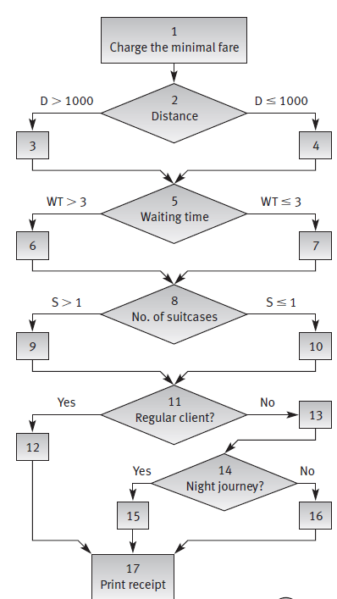

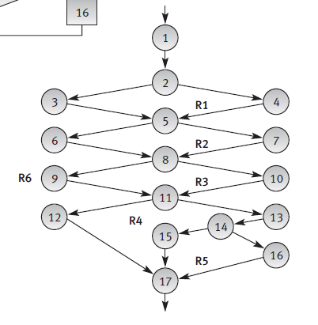
Example: – The Imperial Taxi Services (ITS) taximeter
(a) Flow chart of the module
(b) Program flow graph of the module
dd

Slide 30
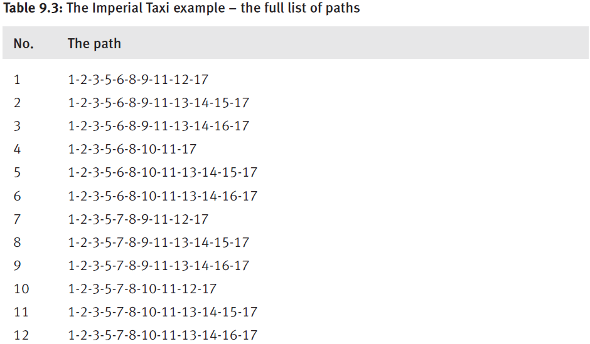
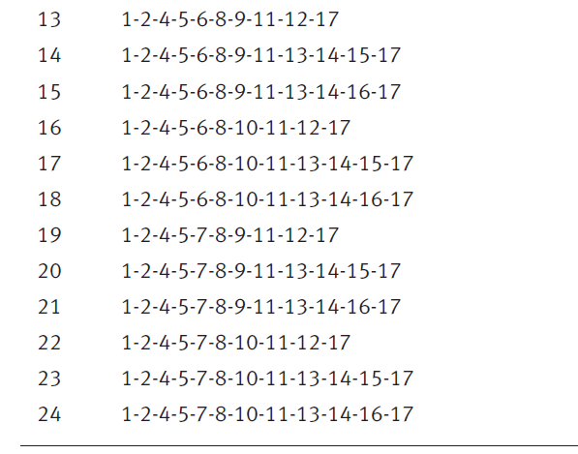
Example: – The Imperial Taxi Services (ITS) taximeter
…..
….

Slide 31
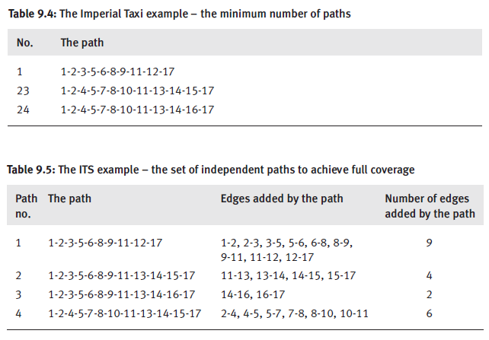
Example: – The Imperial Taxi Services (ITS) taximeter
…..
….

Slide 32
5. Black box testing
Black box testing allows us to perform output correctness tests and most classes of tests as shown in Table (…next).

Slide 33
3. Software test classifications
White box and black box testing for the various classes of tests

Slide 34
5. Black box testing
Black box testing allows us to perform output correctness tests and most classes of tests as shown in Table xx.
We will discuse the following issues:
■ Equivalence classes and their effect on the number of test cases required for output correctness test.
■ Other classes of black box tests.
■ Advantages and disadvantages of black box testing.

Slide 35
9.5.1 Equivalence classes for output correctness tests
Equivalence classes (EC) is a black box method aimed at increasing the efficiency of testing and improving coverage of potential error conditions.

Slide 36

9.5.1 Equivalence classes for output correctness tests
An equivalence class (EC) is a set of input variable values that produce the same output results or that are processed identically.
EC boundaries are defined by a single numeric or alphabetic value, a group of numeric or alphabetic values, a range of values, and so on.

Slide 37
9.5.1 Equivalence classes for output correctness tests
An EC that contains only valid states is defined as a "valid EC," whereas an EC that contains only invalid states is defined as the "invalid EC."
In cases where a program's input is provided by several variables, valid and invalid ECs should be defined for each variable.

Slide 38
9.5.1 Equivalence classes for output correctness tests
Rules According to the EC partitioning method:
Each valid EC and each invalid EC are included in at least one test case.
Definition of test cases is done separately for the valid and invalid ECs.
In defining a test case for the valid ECs, we try to cover as many as possible “new” ECs in that same test case.
In defining invalid ECs, we must assign one test case to each “new” invalid EC, as a test case that includes more than one invalid EC may not allow the tester to distinguish between the program’s separate reactions to each of the invalid ECs.
Test cases are added as long as there are uncovered ECs.

Slide 39
9.5.1 Equivalence classes for output correctness tests
Example – the Golden Splash Swimming Center
The following example illustrates the definition of (valid and invalid) equivalence classes and the corresponding test case values.
The software module in question calculates entrance ticket prices for the Golden Splash Swimming Center.
The Center’s ticket price depends on four variables:
day (weekday, week- end),
visitor’s status (OT = one time, M = member),
entry hour (6.00–19.00, 19.01–24.00)
and visitor’s age (up to 16, 16.01–60, 60.01–120).

Slide 40
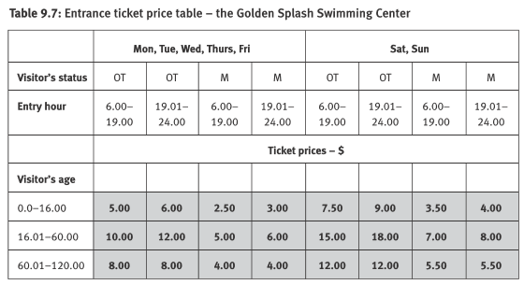
9.5.1 Equivalence classes for output correctness tests
Example – the Golden Splash Swimming Center
The following example illustrates the definition of (valid and invalid) equivalence classes and the corresponding test case values.
The software module in question calculates entrance ticket prices for the Golden Splash Swimming Center.
The Center’s ticket price depends on four variables:
day (weekday, week- end),
visitor’s status (OT = one time, M = member),
entry hour (6.00–19.00, 19.01–24.00)
and visitor’s age (up to 16, 16.01–60, 60.01–120).

Slide 41
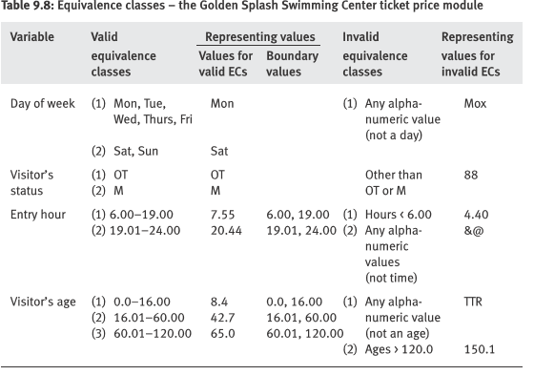

9.5.1 Equivalence classes for output correctness tests
Example – the Golden Splash Swimming Center
A total of 15 ECs were defined for the ticket price module:
nine valid ECs and
six invalid ECs.
The test cases that correspond to these ECs apply the representing values listed in Table 9.8.
The test cases for these ECs, including their boundary values, are presented in Table 9.9.

Slide 42
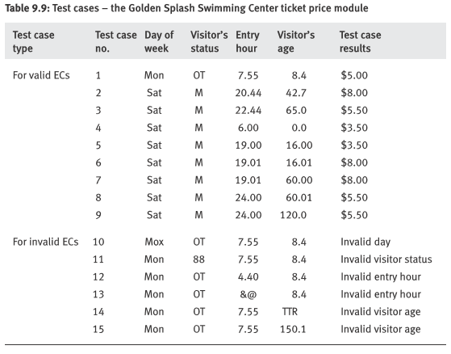



9.5.1 Equivalence classes for output correctness tests
Example – the Golden Splash Swimming Center
A total of 15 ECs were defined for the ticket price module:
nine valid ECs and
six invalid ECs.
The test cases that correspond to these ECs apply the representing values listed in Table 9.8.
The test cases for these ECs, including their boundary values, are presented in Table 9.9.

Slide 43
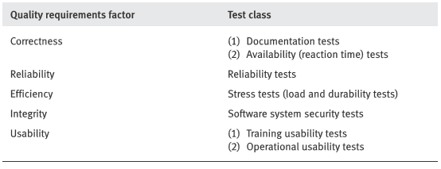
9.5.2 Other classes of black box tests
Apart from output correctness tests, operation factor testing classes include the following classes of tests:

Slide 44
9.5.2 Other classes of black box tests
Documentation tests:
Important because ….
An erroneous user manual or programmer manual can lead to mistakes during program operation and maintenance that may incur damages equivalent in severity to those caused by software bugs.
Common components of documentation, supplied by the developer, are:
Functional descriptions of the software system.
Installation manual
User manual
Programmer manual.

Slide 45
9.5.2 Other classes of black box tests
Documentation tests:
Document testing plans should include the following three components:
■ Document completeness check. Based on the requirements specification and the detailed design reports, its purpose is to check whether all the required documents have been completed as specified and as intended by the designer.
■ Document correctness tests. Correctness tests determine whether the instructions listed in the user document are correct
■ Document style and editing inspection. Refers to document clarity and its agreement with documentation standards in cases this requirement is specified in the contract.

Slide 46

9.5.2 Other classes of black box tests
Apart from output correctness tests, operation factor testing classes include the following classes of tests:
Availability tests:
Availability is defined as reaction time – i.e. the time needed to obtain the requested information or the time required for firmware installed in computerized equipment to react.

Slide 47
9.5.2 Other classes of black box tests
Apart from output correctness tests, operation factor testing classes include the following classes of tests:
Reliability tests:
The software system reliability requirement deals with features that can be translated as events occurring over time, such as average time between fail- ures (e.g., 500 hours), average time for recovery after system failure (e.g., 15 minutes), or average downtime per month (e.g., 30 minutes per month)

Slide 48
9.5.2 Other classes of black box tests
Apart from output correctness tests, operation factor testing classes include the following classes of tests:
Stress tests
two main types of tests: load tests and durability tests.

Slide 49
9.5.2 Other classes of black box tests
Apart from output correctness tests, operation factor testing classes include the following classes of tests:
Stress tests
Load tests relate to the functional performance of the system under maximal operational load: maximal transactions per minute, hits per minute to an Internet site and the like.
Load tests, which are usually conducted for loads higher than those indicated in the requirements specification, are of utmost importance for software systems planned to serve simultaneously a large population of users.

Slide 50
9.5.2 Other classes of black box tests
Apart from output correctness tests, operation factor testing classes include the following classes of tests:
Stress tests
Durability tests
are carried out in physically extreme operating conditions such as high temperatures, humidity, and high-speed driving along unpaved rural roads, as detailed in the durability specification requirements.

Slide 51
9.5.2 Other classes of black box tests
Apart from output correctness tests, operation factor testing classes include the following classes of tests:
Software system security tests … of software systems
are aimed at preventing unauthorized access to the system or parts of it, detection of unauthorized access and the activities performed by the penetration, and the recovery of damages caused by unauthorized penetration cases.

Slide 52
9.5.2 Other classes of black box tests
Apart from output correctness tests, operation factor testing classes include the following classes of tests:
Software system security tests … of software systems
Access control,
Backup of databases and software files and recovery in cases of system failure.
Logging of transactions, system usage, access trials, and so forth.

Slide 53
9.5.2 Other classes of black box tests
Apart from output correctness tests, operation factor testing classes include the following classes of tests:
Training usability tests
When large numbers of users are involved in operating a system, training usability requirements are added to the testing agenda.
The scope of training usability is defined by the resources needed to train a new employee, in other words, how many hours of training are required for a new employee to achieve a defined level of knowledge with the system or to reach a defined hourly production rate.

Slide 54
9.5.2 Other classes of black box tests
Operational usability tests
The focus of this class of tests is the operator’s productivity, that is, those aspects of the system that affect the performance regularly achieved by system operators, or that are applied mainly for information systems that serve many users.
These tests are of high importance in cases where the workings of the system can affect substantially the productivity of its users.
Apart from output correctness tests, operation factor testing classes include the following classes of tests:

Slide 55
9.5.2 Other classes of black box tests
Revision factor testing classes
Easy revision of software is a fundamental factor assuring a software pack- age’s successful, long service and its successful sales to larger user populations.
Related to these features are the revision testing classes dis- cussed in this section:
■ Maintainability tests
■ Flexibility tests
■ Testability tests.

Slide 56
9.5.2 Other classes of black box tests
■ Maintainability tests
The importance of software maintenance and maintainability can never be overestimated; consider the fact that these functions consume more than 60% of total design and programming resources invested in a software sys- tem throughout its life cycle (Pressman, 2000).
Maintainability tests relate mainly to these issues:
The system structure respects the standards and development procedures imposed on the specific components for support of future maintenance activities, including the modular structure of self-contained modules and module size.
The programmer’s manual is prepared according to approved documentation standards and provides complete system documentation.
The internal documentation incorporated in the software code is prepared according to coding procedures and conventions and fully covers the system’s documentation requirements.

Slide 57



9.5.2 Other classes of black box tests
Revision factor testing classes
■ Flexibility tests
Software system flexibility refers to the system’s capabilities, based on its structural and programming characteristics.
These factors significantly affect the efforts required to adapt the software to the variety of customer needs as well as to introduce changes initiated by customers and maintenance teams for the purpose of improving system functionality.
■ Testability tests
Testability requirements deal with the ease of testing the software system.

Slide 58
9.5.2 Other classes of black box tests
Transition factor testing classes
The software characteristics required to be operative, with minor adaptations, in different environments, and those needed to incorporate reused modules or to permit interfacing with other software packages
Hence, we have:
Portability tests
Reusability tests
Tests for interoperability requirements:
■ Software interfacing tests
■ Equipment interfacing tests.

Slide 59
9.5.2 Other classes of black box tests
Transition factor testing classes
Portability tests
Portability requirements specify the environments (or environmental condi- tions) in which the software system has to be operable: the operating systems, hardware and communication equipment standards, among other variables.
The portability test to be carried out will verify, validate and test these factors as well as estimate the resources required for transfer of a software system to a different environment.

Slide 60
9.5.2 Other classes of black box tests
Transition factor testing classes
Reusability tests
Reusability requirements are of special importance for object-oriented soft- ware projects.
Tests are therefore devised to examine whether reusability standards were indeed adhered to.

Slide 61
9.5.2 Other classes of black box tests
Transition factor testing classes
Tests for interoperability requirements:
■ Software interfacing tests
The requirements list delineates the specific equipment and/or software interfaces to be tested, as well as the applicable data transfer and interfacing standards.
■ Equipment interfacing tests.
The relevant tests should examine implementation of the equipment interoperability requirements throughout the system.

Slide 62
9.5.3 Advantages and disadvantages of black box testing
The main advantages of black box testing are:
a. Black box testing allows us to carry out the majority of testing classes, most of which can be implemented solely by black box tests Tests for interoperability requirements;
b. For testing classes that can be carried out by both white and black box tests, black box testing requires fewer resources than those required for white box testing of the same software package.

Slide 63

9.5.3 Advantages and disadvantages of black box testing
The main disadvantages of black box testing are:
a. Possibility that coincidental aggregation of several errors will produce the correct response for a test case, and prevent error detection;
b. Absence of control of line coverage. Bb tests may not execute a substantial proportion of the code lines, which are not covered by a set of test cases.
c. Impossibility of testing the quality of coding and its strict adherence to the coding standards.

Slide 64
Software testing - implementation
Presentation 10
The testing process
Test case design
Automated testing
Alpha and beta site testing programs

Slide 65
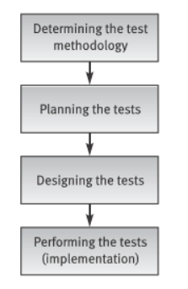
10.1 Testing process
Planning, design and performance of testing are carried out throughout the software development process.
These activities are divided in phases, beginning in the design stage and ending when the software is installed at the customer’s site.
The testing process is illustrated in the next Figure.

Slide 66
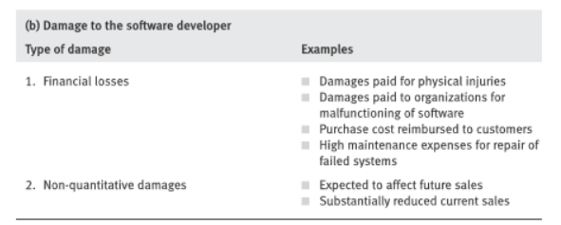
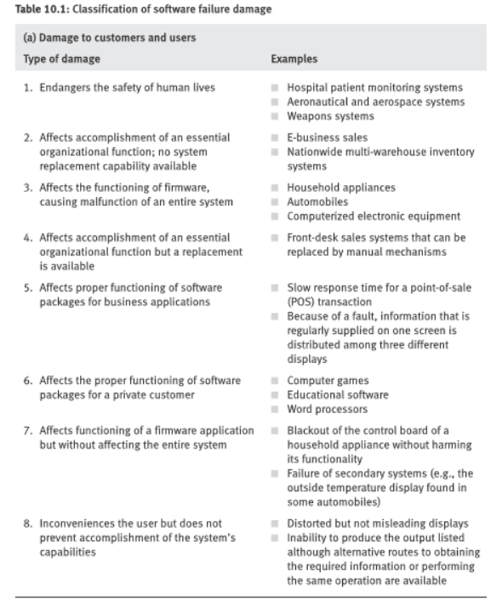
10.1 Testing process
Determiming the test methodology:
The level of quality standard selected for a project depends mainly on the characteristics of the software’s application.
■ A software package for a hospital patient bed monitor
requires the highest software quality standard
considering the possibly severe consequences of
software failure.
■ A package developed for handling feedback
information for an organization’s internal employee
training program could make do with a medium-level
software quality standard.

Slide 67
Classification of
software failure damages –
Damages to Customers and Users
1. Endangers the safety of human beings
2. Affects an essential organizational function with no system replacement capability available
3. Affects functioning of firmware, causing malfunction of an entire system
4. Affects an essential organizational function but a replacement is available
5. Affects proper functioning of software packages for business applications
6. Affects proper functioning of software packages for a private customer
7. Affects functioning of a firmware application but without affecting the entire system.
8. Inconveniences the user but does not prevent accomplishment of the system’s capabilities

Slide 68
Classification of
software failure damages –
Damages to the software developer
1. Financial losses
* Damages paid for physical injuries
* Damages paid to organizations for malfunctioning of software
* Purchase cost reimbursed to customers
* High maintenance expanses for repair of failed systems
2. Non-quantitative damages
* Expected to affect future sales
* Substantially reduced current sales

Slide 69
10.1 Testing process
Planing the tests:
The tests to be planned include:
* Unit tests
* Integration tests
System tests.
It is mandatory upon planners to consider the following issues before ini- tiating a specific test plan:
What to test?
Which sources to use for test cases?
Who is to perform the tests?
Where to perform the tests?
When to terminate the tests?

Slide 70
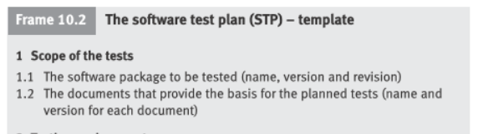
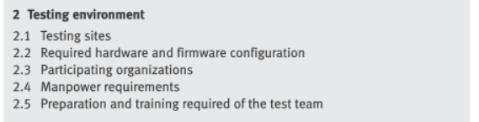
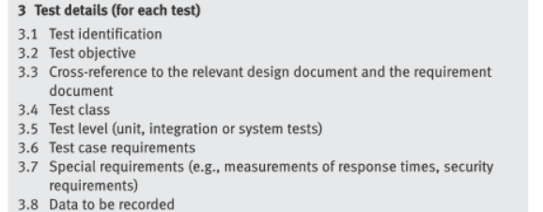
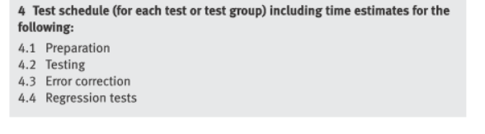
10.1 Testing process
Planing the tests:
The planning stage of the software system tests is commonly documented in a “software test plan” (STP).

Slide 71
Software test plan
(STP) - template
1 Scope of the tests
1.1 The software package to be tested (name, version and revision)
1.2 The documents that provide the basis for the planned tests
2 Testing environment
2.1 Sites
2.2 Required hardware and firmware configuration
2.3 Participating organizations
2.4 Manpower requirements
2.5 Preparation and training required of the test team

Slide 72
Software test plan
(STP) - template (cont.)
3 Tests details (for each test)
3.1 Test identification
3.2 Test objective
3.3 Cross-reference to the relevant design document and the requirement document
3.4 Test class
3.5 Test level (unit, integration or system tests)
3.6 Test case requirements
3.7 Special requirements (e.g., measurements of response times, security requirements)
3.8 Data to be recorded
4 Test schedule (for each test or test group) including time estimates for:
4.1 Preparation
4.2 Testing
4.3 Error correction
4.4 Regression tests

Slide 73
10.1 Testing process
Test design phase:
The products of the test design stage are:
■ Detailed design and procedures for each test
■ Test case database/file.
The test procedures and the test case database/file
may be documented in a “software test procedure”
document and “test case file” document or in a single document called the “software test description” (STD).

Slide 74
Software test
description (STD) - template
1 Scope of the tests
1.1 The software package to be tested (name, version and revision)
1.2 The documents providing the basis for the designed tests (name and version for each document)
2 Test environment (for each test)
2.1 Test identification (the test details are documented in the STP)
2.2 Detailed description of the operating system and hardware configuration and the required switch settings for the tests
2.3 Instructions for software loading
3. Testing process
3.1 Instructions for input, detailing every step of the input process
3.2 Data to be recorded during the tests
4. Test cases (for each case)
4.1 Test case identification details
4.2 Input data and system settings
4.3 Expected intermediate results (if applicable)
4.4 Expected results (numerical, message, activation of equipment, etc.)
5. Actions to be taken in case of program failure/cessation
6. Procedures to be applied according to the test results summary

Slide 75
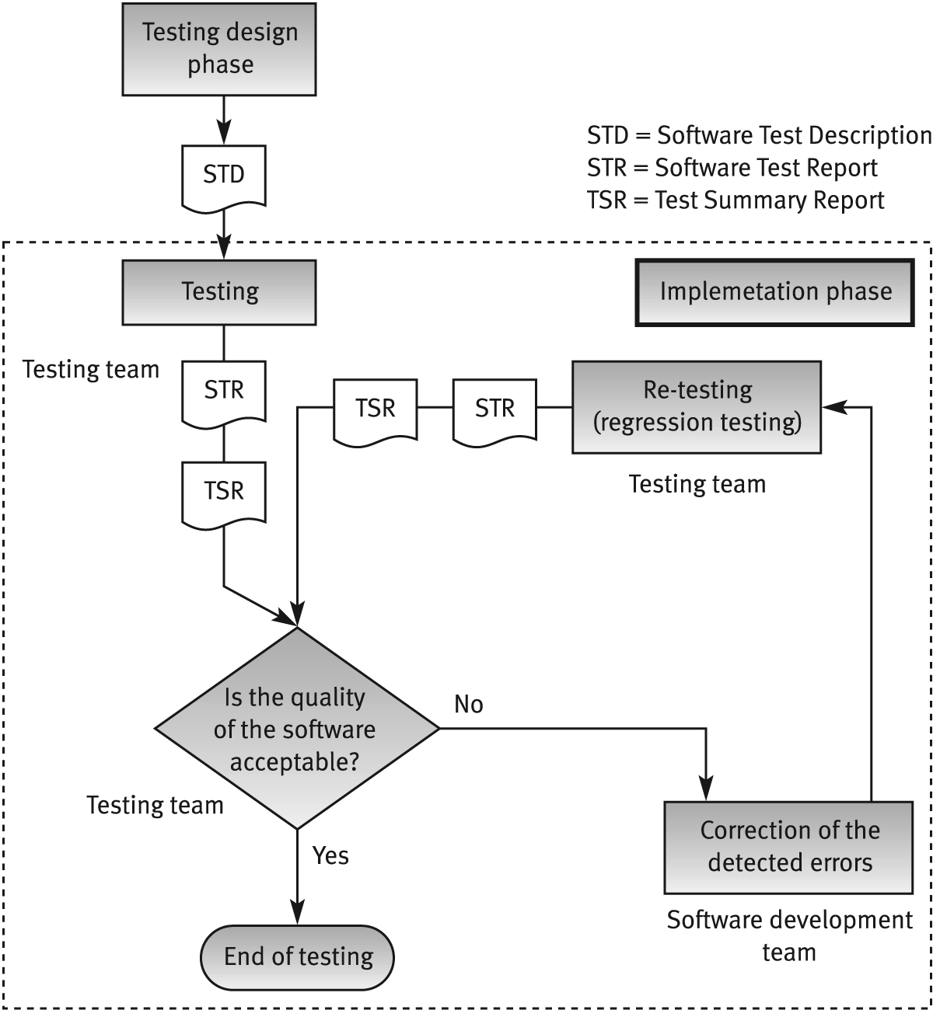
10.1 Testing process
Implementation phase activities:

Slide 76
Software test report (STR) - template
1. Test identification, site, schedule and participation
1.1 The tested software identification (name, version and revision)
1.2 The documents providing the basis for the tests (name and version for each document)
1.3 Test site
1.4 Initiation and concluding times for each testing session
1.5 Test team members
1.6 Other participants
1.7 Hours invested in performing the tests
2. Test environment
2.1 Hardware and firmware configurations
2.2 Preparations and training prior to testing

Slide 77
Software test report
(STR) - template (cont.)
3. Test results
3.1 Test identification
3.2 Test case results (for each test case individually)
4. Summary tables for total number of errors, their distribution and types
4.1 Summary of current tests
4.2 Comparison with previous results (for regression test summaries)
5. Special events and testers' proposals
5.1 Special events and unpredicted responses of the software during testing
5.2 Problems encountered during testing.
5.3 Proposals for changes in the test environment, including test preparations
5.4 Proposals for changes or corrections in test procedures and test case files

Slide 78
10.3 Automated testing
Several factors have motivated the development of automated testing tools:
- anticipated cost savings,
- shortened test duration,
- heightened thoroughness of the tests performed,
- improvement of test accuracy,
- improvement of result reporting as well as statistical processing
- and subsequent reporting.
Notes:
thoroughness = meticulozitate !!

Slide 79
10.3 Automated testing
This section covers:
■ The process of automated testing
■ The types of automated tests
■ The advantages and disadvantages of automated tests.

Slide 80
10.3 Automated testing
■ The process of automated testing
Automated software testing requires:
test planning,
test design,
test case preparation,
test performance,
test log and report preparation,
re-testing after correction of detected errors (regression tests),
and final test log and report preparation including comparison reports.

Slide 81
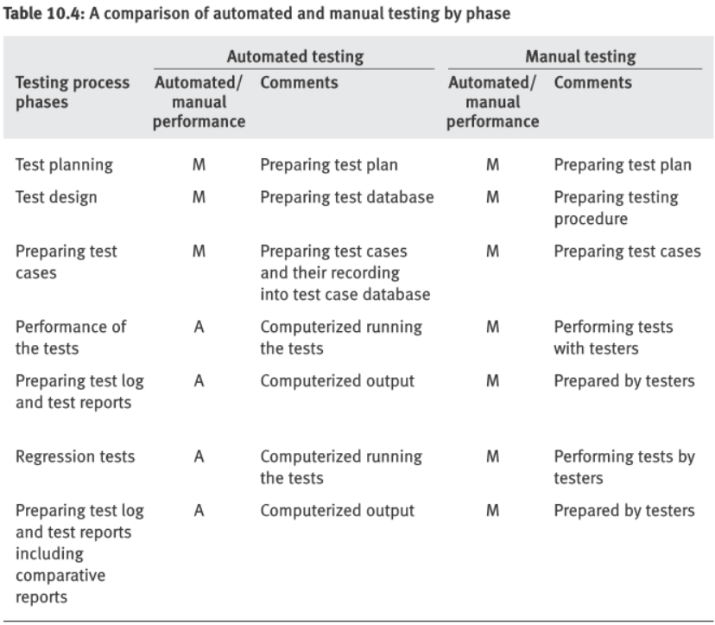
10.3 Automated testing
■ The process of automated testing
A comparison of automated and manual testing is presented in the next Table.

Slide 82
Comparison of automated
and manual testing by phase
Testing process phase | Automated testing | Manual testing
Test planning | M | M
Test design | M | M
Preparing test cases | M | M
Performance of the tests | A | M
Preparing the test log and test reports | A | M
Regression tests | A | M
Preparing the tests log and test reports including comparative reports | M | M
Test planning | M | M
Test design | A | M
M = phase performed manually, A= phase performed automatically

Slide 83
10.3 Automated testing
■ The types of automated tests
The main types of automated tests
■ Code auditing
■ Coverage monitoring
■ Functional tests
■ Load tests
■ Test management

Slide 84
10.3 Automated testing
■ The types of automated tests ■ Code auditing
The computerized code auditor checks the compliance of code to specified standards and procedures of coding.
The auditor’s report includes a list of the deviations from the standards and a statistical summary of the findings.

Slide 85
10.3 Automated testing
■ The types of automated tests ■ Code auditing
A code auditor can verify the following:
Does the code fulfill code structure instructions and procedures?
Module size. Some code auditors calculate for the tested code complexity metrics, such as McCabe’s cyclomatic complexity metrics – Levels of loop nesting – Levels of subroutine nesting – Prohibited constructs, such as GOTO.
Does the coding style follow the coding style procedures?
– Naming conventions for variables, files, etc. – Unreachable code lines of program or entire subroutines.
Do the internal program documentation and help support sections follow the coding style procedures?
Format and size of comments:
– Location of comments in the file – Help index and presentation style.

Slide 86
10.3 Automated testing
■ The types of automated tests: Coverage monitoring
Coverage monitors produce reports about the line coverage achieved when implementing a given test case file.
The monitor’s output includes the percentage of lines covered by the test cases as well as listings of uncovered lines.
These features make coverage monitoring a vital tool for white-box tests.

Slide 87
10.3 Automated testing
■ The types of automated tests: Functional tests
Automated functional tests often replace manual black-box correctness tests.
Prior to performance of these tests, the test cases are recorded into the test case database.
The test results documentation includes listings of the errors identified in addition to a variety of summaries and statistics as demanded by the testers’ specifications.

Slide 88
10.3 Automated testing
■ The types of automated tests: Load tests
For load tests to be performed, the maximal load environment must first be created.
If executed manually, the tests must be conducted when the sys- tem is under maximal user load, a condition that is impractical in most cases and impossible in others.
Therefore the only way to carry out load tests for medium-sized and large systems is by means of computerized simulations that can be programmed to closely approach real load conditions.
The load tests themselves are based on scenarios of the maximal load sit- uations, that the software system is expected to confront and deal with.

Slide 89
10.3 Automated testing
■ The types of automated tests: Load tests
For operating scenarios devised for load testing, virtual users and virtual events are generated and operated in a hardware and communication environment defined by the system planner.
The simulation’s required loads and frequencies are also created by computerization.
The simulation then produces outputs similar to those captured from real-life users at the frequencies and with the user mix defined by the scenario.
These outputs serve as inputs for the tested software.

Slide 90
10.3 Automated testing
■ The types of automated tests: Load tests
The computerized monitoring of the load tests produces software system performance measurements in terms of reaction time, processing time, and other desired parameters.
The computer-produced tables and graphs, based on the performance measurement information, allow the tester to decide what changes are to be introduced into each simulation for each test iteration.
Example:
■ Change the hardware, including the communication system, to allow the software system to fulfill its performance requirements at each load level.
■ Change the scenario in order to reveal the load contributed by each user or event.

Slide 91
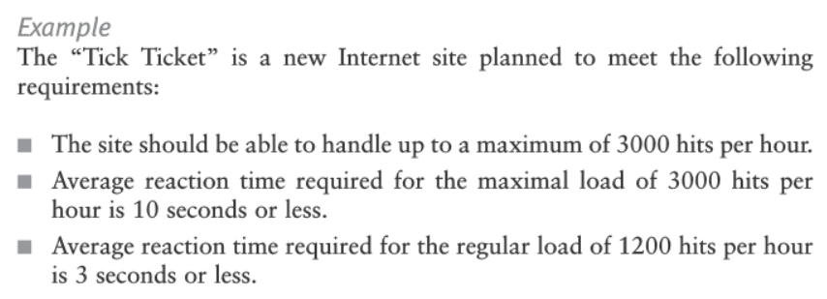
10.3 Automated testing
■ The types of automated tests: Load tests
Example:

Slide 92
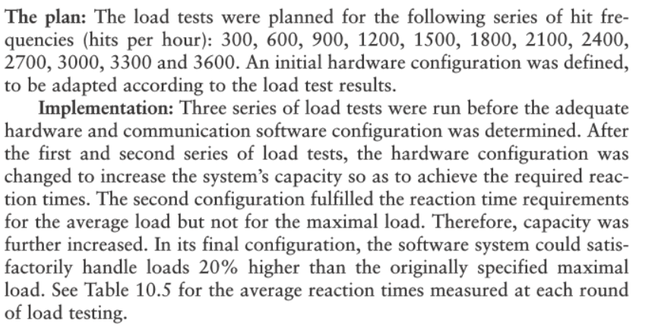
10.3 Automated testing
■ The types of automated tests: Load tests
Example:

Slide 93
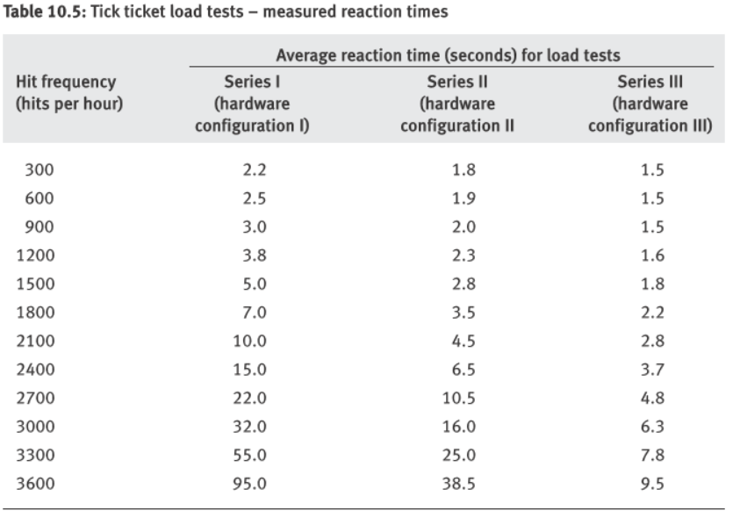
10.3 Automated testing
■ The types of automated tests: Load tests
Example:

Slide 94
10.3 Automated testing
■ The types of automated tests: Test management
In general,
computerized test management tools are planned to provide testers with reports, lists and other types of information at levels of quality and availability that are higher than those provided by manual test management systems.
Especially important here is the package’s interoperability with respect to the automated testing tools.

Slide 95
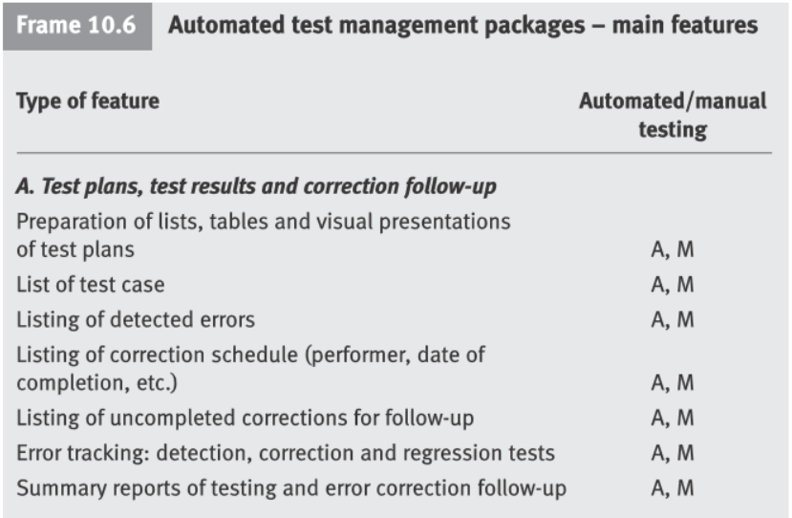
10.3 Automated testing
■ The types of automated tests: Test management
In general,
computerized test management tools are planned to provide testers with reports, lists and other types of information at levels of quality and availability that are higher than those provided by manual test management systems.

Slide 96
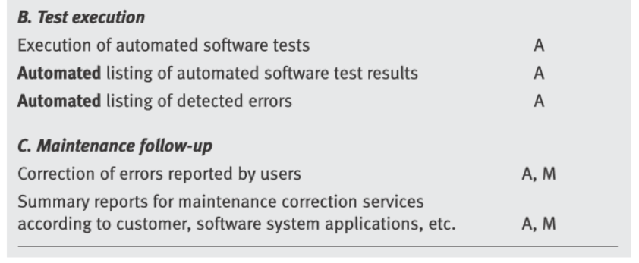
10.3 Automated testing
■ The types of automated tests: Test management
In general,
computerized test management tools are planned to provide testers with reports, lists and other types of information at levels of quality and availability that are higher than those provided by manual test management systems.

Slide 97
10.3 Automated testing
■ Advantages and disadvantages of automated tests
The decision to employ automated testing tools is difficult to make
because of the substantial investments involved in purchasing the tools
and in adequately training a team for their effective and efficient implementation.

Slide 98
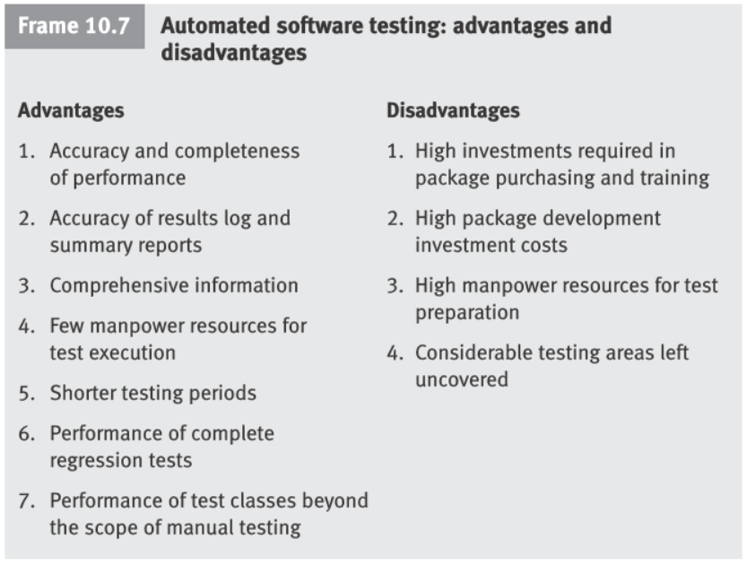
10.3 Automated testing
■ Advantages and disadvantages of automated tests
The decision to employ automated testing tools is difficult to make
because of the substantial investments involved in purchasing the tools
and in adequately training a team for their effective and efficient implementation.

Slide 99
Advantages and disadvantages
of automated testing
Advantages
Accuracy and completeness of performance.
Accuracy of results log and summary reports.
Comprehensiveness of information.
Few manpower resources required for performing of tests.
Shorter duration of testing.
Performance of complete regression tests.
Performance of test classes beyond the scope of manual testing.
Disadvantages
High investments required in package purchasing and training.
High package development investment costs.
High manpower requirements for test preparation.
Considerable testing areas left uncovered.

Slide 100
10.4 Alpha and Beta site testing programs
Alpha site and beta site tests are employed to obtain comments about quality from the package’s potential users.
In a way, alpha and beta site tests replace the customer’s acceptance test.
Alpha site tests
“Alpha site tests” are tests of a new software package that are performed at the developer’s site.
The customer tends to examine the package from angles not expected by the testing team.
The errors identified by alpha site tests are expected to include the errors that only use by a real user can reveal, and thus should be reported to the developer.

Slide 101
10.4 Alpha and Beta site testing programs
Beta site tests
Once an advanced version of the software package is available, the developer offers it free of charge to one or more potential users.
The users install the package in their sites (usually called the “beta sites”), with the understanding that they will inform the developer of all the errors revealed during trials or regular usage.
Participants in beta site testing are often users of previously released pack- ages, sophisticated software professionals and the like.
Because beta site tests are considered to be a valuable tool, some developers involve hundreds or even thousands of participants in the process.

Slide 102
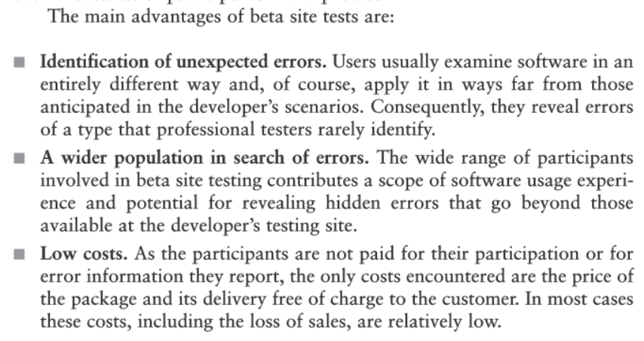
10.4 Alpha and Beta site testing programs
Beta site tests

Slide 103
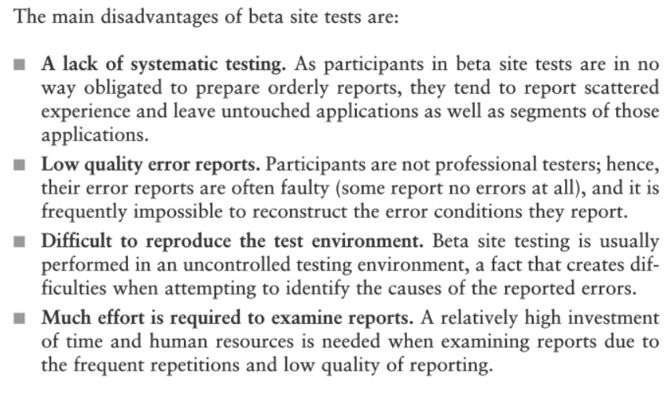
10.4 Alpha and Beta site testing programs
Beta site tests

Slide 104
Advantages and disadvantages
of beta site tests
Advantages
Identification of unexpected errors.
A wider population in search of errors.
Low costs.
Disadvantages
A lack of systematic testing.
Low quality error reports.
Difficult to reproduce the test environment.
Much effort is required to examine reports.

